Slide 1
Analysis of Family Planning Data
-Bipul Kumar
-2014CS50282

Slide 2
Why
Program managers and policy makers have the responsibility to orchestrating resources, staff, and service structures to meet the needs of many thousands and, in some cases, many millions of individuals.
But in the past, there have been few tools to guide managers and policy makers. They had lacked a picture of what the population gets in the form of care.
That’s where Data analysis comes to rescue. One gathers the informations regarding public health of population. And data analysis offers a picture of how systems are working and where it is lacking in its impact.
It helps them achieve the efficient use of resources with the maximum impact.

Slide 3
Our Job
Gather Evidence
Explore
Understand

Slide 4
Our Job
Step 1
Gather Evidence
Gather the evidence of the impact of family planning programs on three key sets of outcome variables: fertility preferences, contraceptive method choice, and fertility.
Explore
Understand

Slide 5
Our Job
STEP 2
Gather Evidence
Understanding the characteristics of the 284 districts within 9 high priority states of MPV with respect to geographic, socio-economic, demographic, family planning and fertility outcomes.
Explore
Understand

Slide 6
Our Job
STEP 3
Gather Evidence
Explore factors which best explain the variations in policy impact across districts to a precision that is policy relevant for different stakeholders.
Explore
Understand

Slide 7
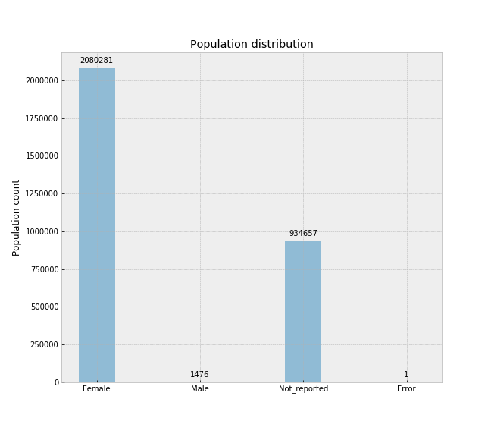
Results so far
Around 1/3rd of our data is empty.
They have less than 7 columns filled out of 31. Better drop it.
Also drop data from male, because we are looking to make observations based on females only.

Slide 8
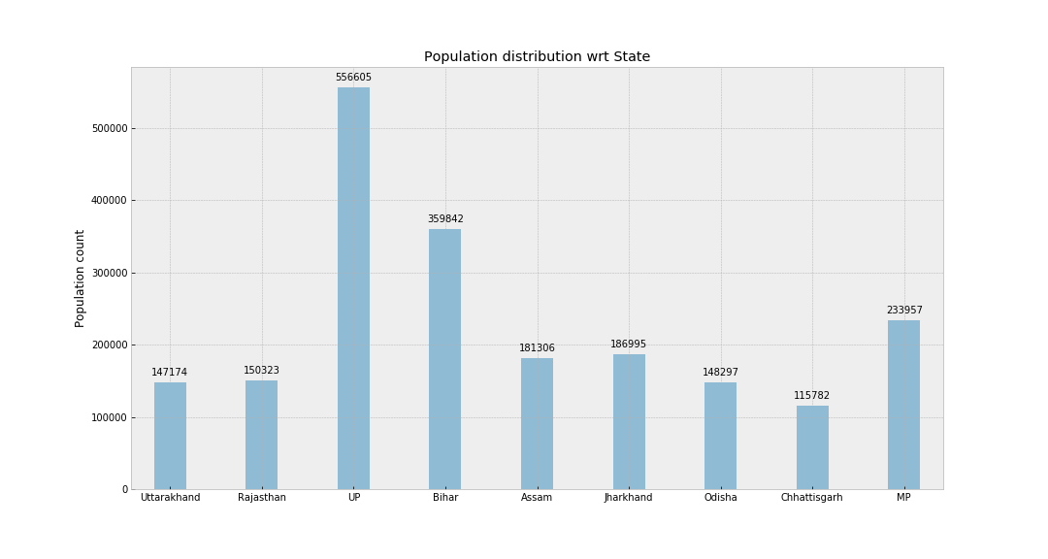
Population distribution wrt State

Slide 9
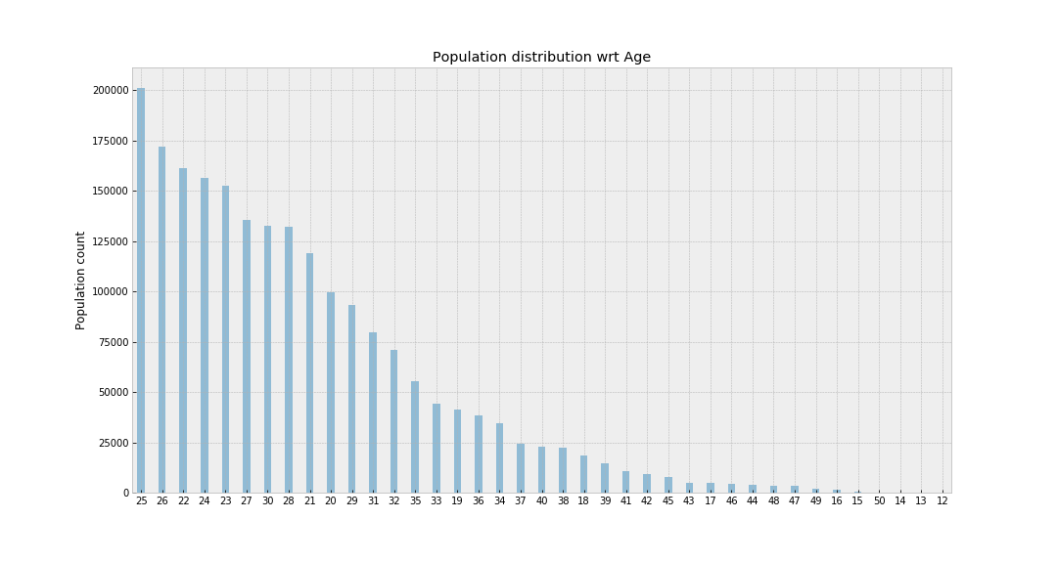
Population distribution wrt Age

Slide 10
Results so far
0.5% of women are widows.
50% of the widows in out data are of age less than 28 years.
Most of the columns for widows are empty, so we will remove currently_widow column from further consideration.
Those whose year of birth was missing we filled them with mean age of population.
We also removed people who born before 1960 or after 1999.

Slide 11
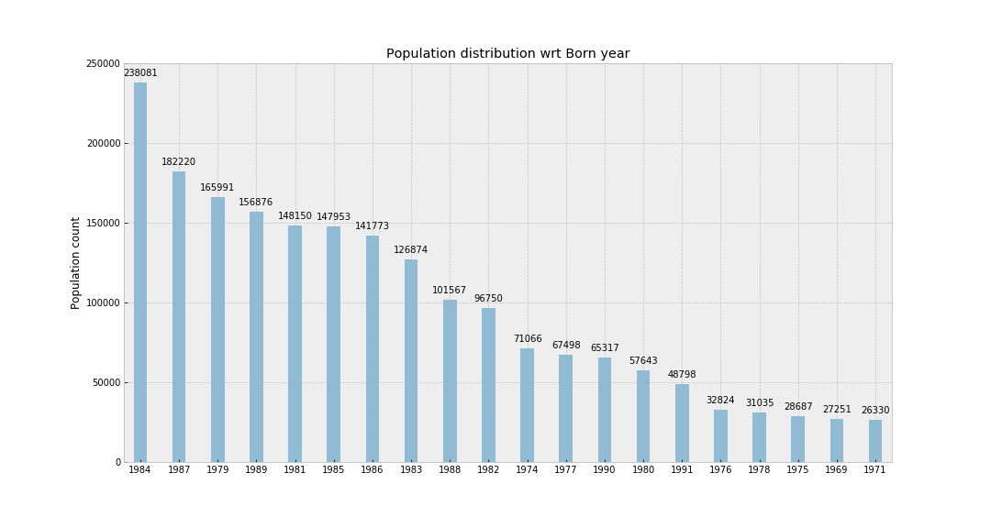
Population distribution wrt Born year

Slide 12
Results so far
Less than 10% columns are empty. That maybe due to female may not have given birth to baby yet.
So we will extrapolate the data and fill these by assuming that they will have their first baby when:
their age = mean(age of population when their first baby was born)
min age of woman when she had first child is 11 years.
the average age of women at first born child is 21 years.
75% of women have their first child at the age of 23 years while
max age of woman when her first child was born is 49 years.

Slide 13
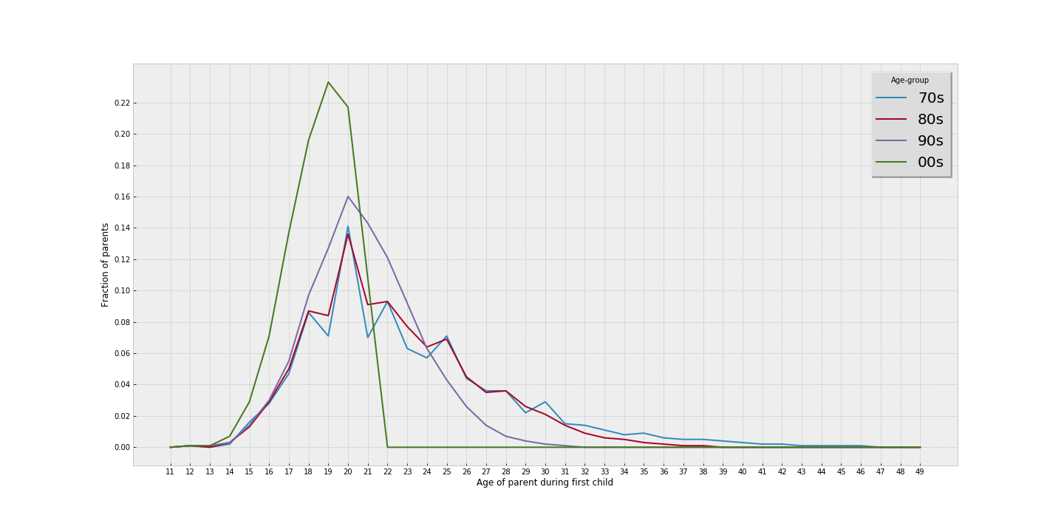
Population distribution wrt Age of parents during 1st child

Slide 14
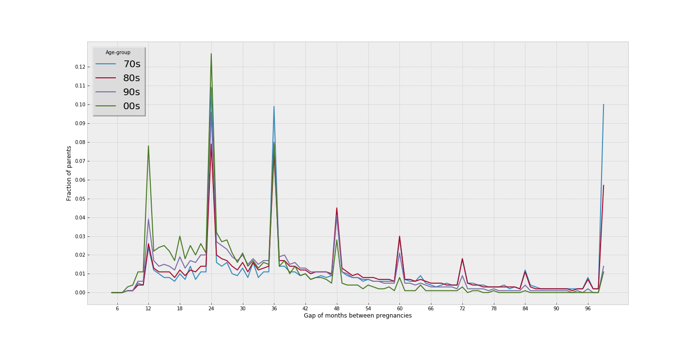
Population distribution wrt Gap of month bw Pregnancies

Slide 15
Results so far
The average no of months between two pregnancies is 34.5 months
50% of women kept at least gap of 33 months between two pregnancies.
There is an interesting pattern of gap of multiples of 12 months between two pregnancy irrespective of women born into which generation.

Slide 16
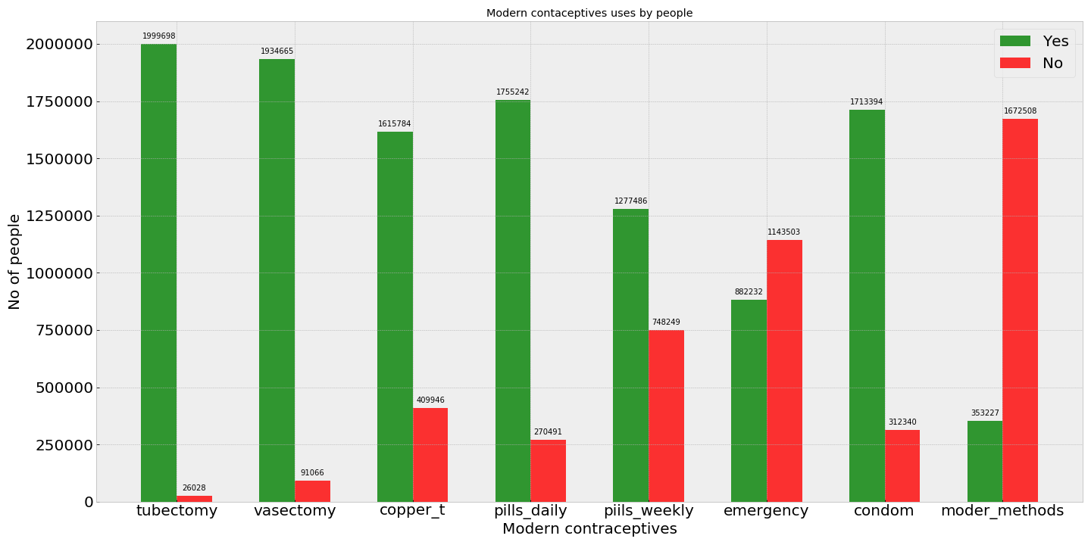
Population distribution wrt Modern Contraceptive Use

Slide 17
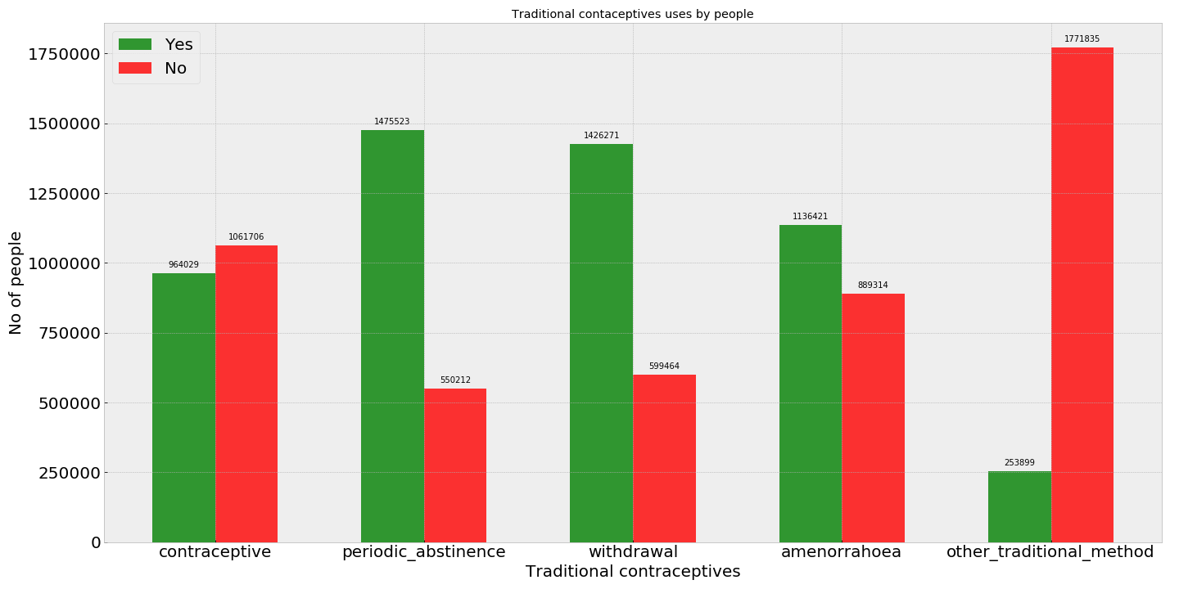
Population distribution wrt Traditional Contraceptive Use

Slide 18
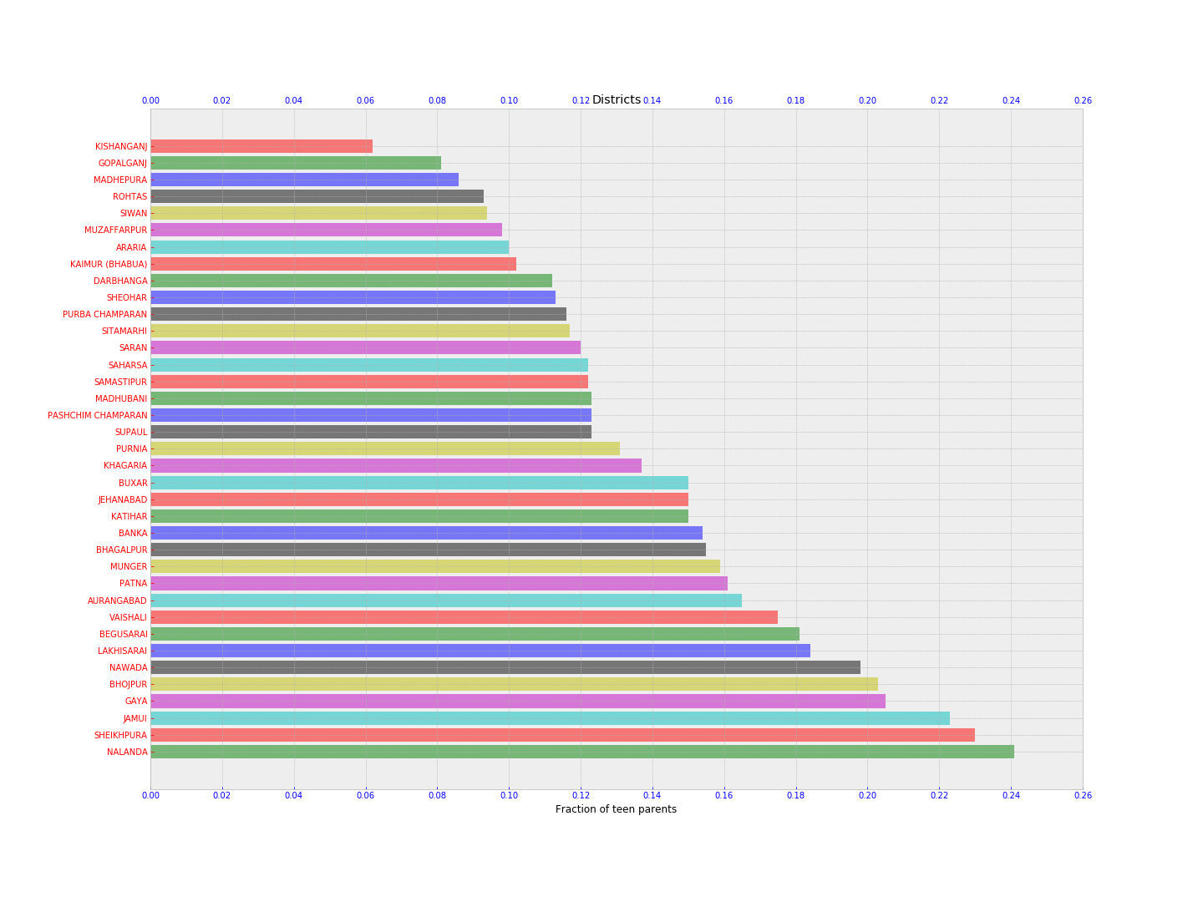
Teen parent distribution in Districts of Bihar

Slide 19
Results so far
Bihar:
Districts from south bihar are worst. Most teenager parents comes from these 6 district: Nalanda, Sheikhpura, Jamui, Gaya, Nawada.
Nalanda, which is constituency of current chief minister Nitish kumar, is the worst performing district.

Slide 20
Results so far
Chhattisgarh:
Raipur, which is the state capital is among the worst performer.
Bastar district, infamous for naxalite attacks is also among worst performer.

Slide 21
Results so far
Uttar Pradesh:
Apart from Lalitpur which has less than 12% of parents teenager, it performs better than all these states.
It has managed to keep teenage parents to less than 8%.

Slide 22
Results so far
Chhattisgarh has most teen parents (14%) population per district.
Alone Kawardha district has more than 31% of population as teenager.
Deoria district of Uttar Pradesh is the best performing district among all these states. There are only 1% of teenage parents here.

Slide 23
Work planned to do
Creating various statistical models to reveal factors on which data patterns behave.
Identifying characteristics of population which is way behind in getting benefits of already existing policies.
Doing explanatory data analysis to get understanding of the results of our expedition so far.

Slide 24
Some more:
Exploring data related to contraceptive uses
Exploring data related to abortion
Exploring data related to mother-child health

Slide 25
Thank you

